Slide 1
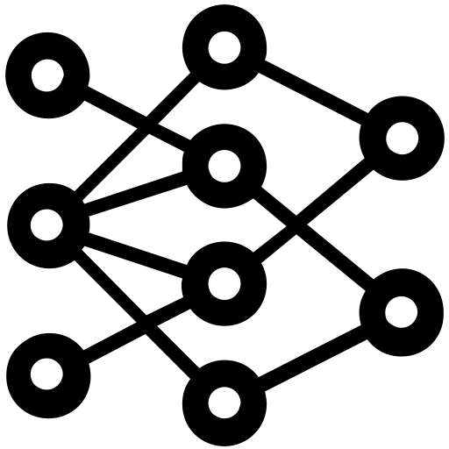




Synthesized Audit Log
DL-based Method
Triplet
Sementic
Inference
Detection
Model
Training
Provenance Graph Builder
Triplets
Embeddings
FFNN
Windows
Audit Logs
Rule-based Method
Triplets / Custom Field Map / Valid Rules
Provenance Graph
registry:
attr:
- OOO: src_ooo - XXX: dst_xxx
relation:
network:
…
Valid Rule
Filter
Multi-process Matcher
selection:
- ZZZ: ^A.*B$
filter:
- XXX: ^(?=.*H)(?=.*I).*$
Triplets
因為真實世界的資料集多沒有標記，因此我們利用 Caldera 紅隊演練及 ProcMon 側錄得到有標記 Technique 的 Audit log 來實驗並驗證。
selection:
- ZZZ: ^A.*B$
filter:
- XXX: ^(?=.*H)(?=.*I).*$
Rule
Converter
selection:
- ZZZ: ^A.*B$
filter:
- XXX: ^(?=.*H)(?=.*I).*$
selection:
- ZZZ: ^A.*B$
filter:
- XXX: ^(?=.*H)(?=.*I).*$
Benign
Sigma Rule
(Human readable)
Rule Database
(Machine readable)
T1111
T2222
T1070.005
TTP
Graph
Reconstruction
TTP graph
(T1070.005)
Detected TTP Triplets
Notes:
DL Anomaly Detector
Rule Matching Engine 裡面的小模組才是重點，要畫出來

Slide 2

Process Monitor Columns

Slide 3

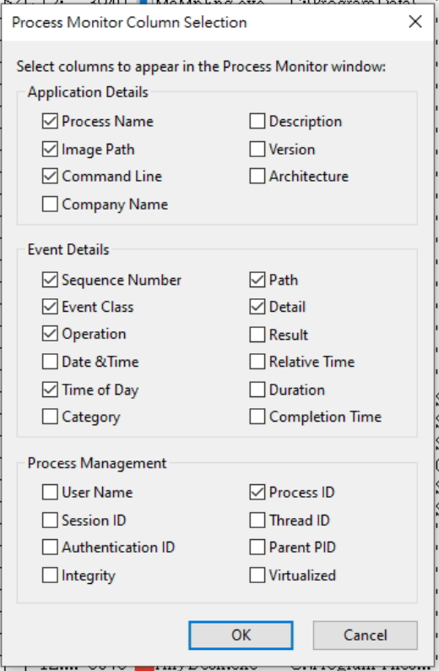
Process Monitor Columns
We selected and organized useful log information to JSON format from 10 of 27 columns in ProcMon.
Process: Name The name of the process in which an event occurred.
Image Path: The full path of the image running in a process.
Command Line: The command line used to launch a process.
Sequence Number: The relative position of the operation with respect to all events included in the current filter.
Event Class: The class (File, Registry, Process) of the event.
Operation: The specific event operation
Time of Day: Time of an operation.
Process ID: The Process ID (PID) of the process that executed an operation.
Path: The path of the resource that an event references.
Detail: Additional information specific to an event.
Fig. Columns in ProcMon
Notes:
https://documentation.help/Process-Monitor/documentation.pdf

Slide 4
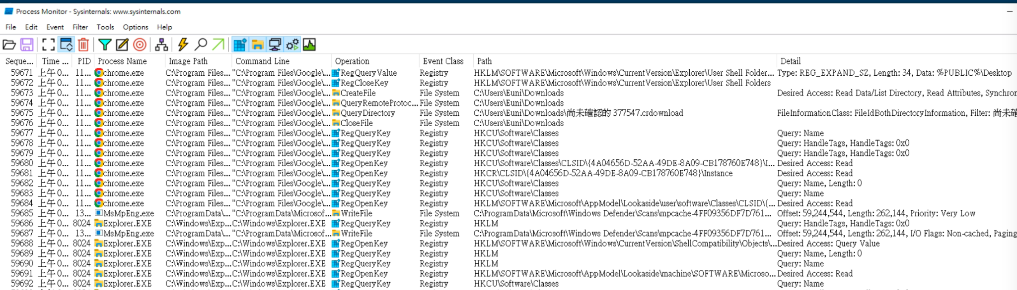
Path
Detail
Sequence
Event Class
Timestamp
Process ID
Operation
Process Name
Image Path
Command Line

Slide 5
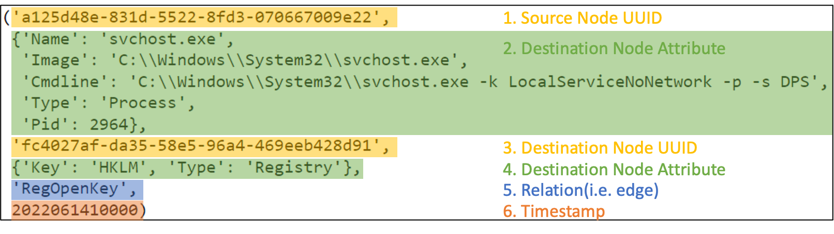
Path
Detail
Sequence
Event Class
Timestamp
Process ID
Operation
實際儲存格式
Process Name
Image Path
Command Line
將該 node 所有的 attributes concat 起來的 string 去 hash 會得到 uuid。

Slide 6
Synthesized 資料集描述
Synthesized 資料集中總事件數量：17,346,525
其中是 TTP 的事件數量：18,334
TTP 的數量是？
各個 TTP 對應的事件數量
其中是 Benign 的事件數量：17,328,191
Entity / Relation 數量

Slide 7
